Slide 1




SUPPLY CHAIN STANDARD OFFERING SYNTHETICS BUSINESS
EXXONMOBIL CHEMICAL ASIA PACIFIC
(A DIVISION OF EXXONMOBIL ASIA PACIFIC PTE LTD)

Slide 2

Contents
3
How do I place an order with ExxonMobil?
10
How can I load my products from ExxonMobil Terminal?
6
How will I be billed?
How do I change/cancel my order?
How can I pay my bill?
11
How do I count demurrage and detention days?
INTRODUCTION
At ExxonMobil, we are dedicated to providing an exceptional customer
Experience, backed by years of supply chain knowledge, capability and experience.
7
How long in advance do I need to prepare for my order?
12
Can I expedite the shipping of my order?
Can I request a sample from ExxonMobil?
How do I provide feedback to ExxonMobil?
What type of documents will I receive with my shipment?
This document provides a comprehensive guide to all our Supply Chain Standard Offerings available to our valued customers. Any non-standard services required can also be arranged upon request and may incur additional fees.
Our Sales representatives and Customer Service teams are readily available through multiple channels should you wish to learn more about our service offerings.
8
What order quantities are available?
13
How do I unload a product?
Notes:
- Corrected the subject for page 7 and 8

Slide 3
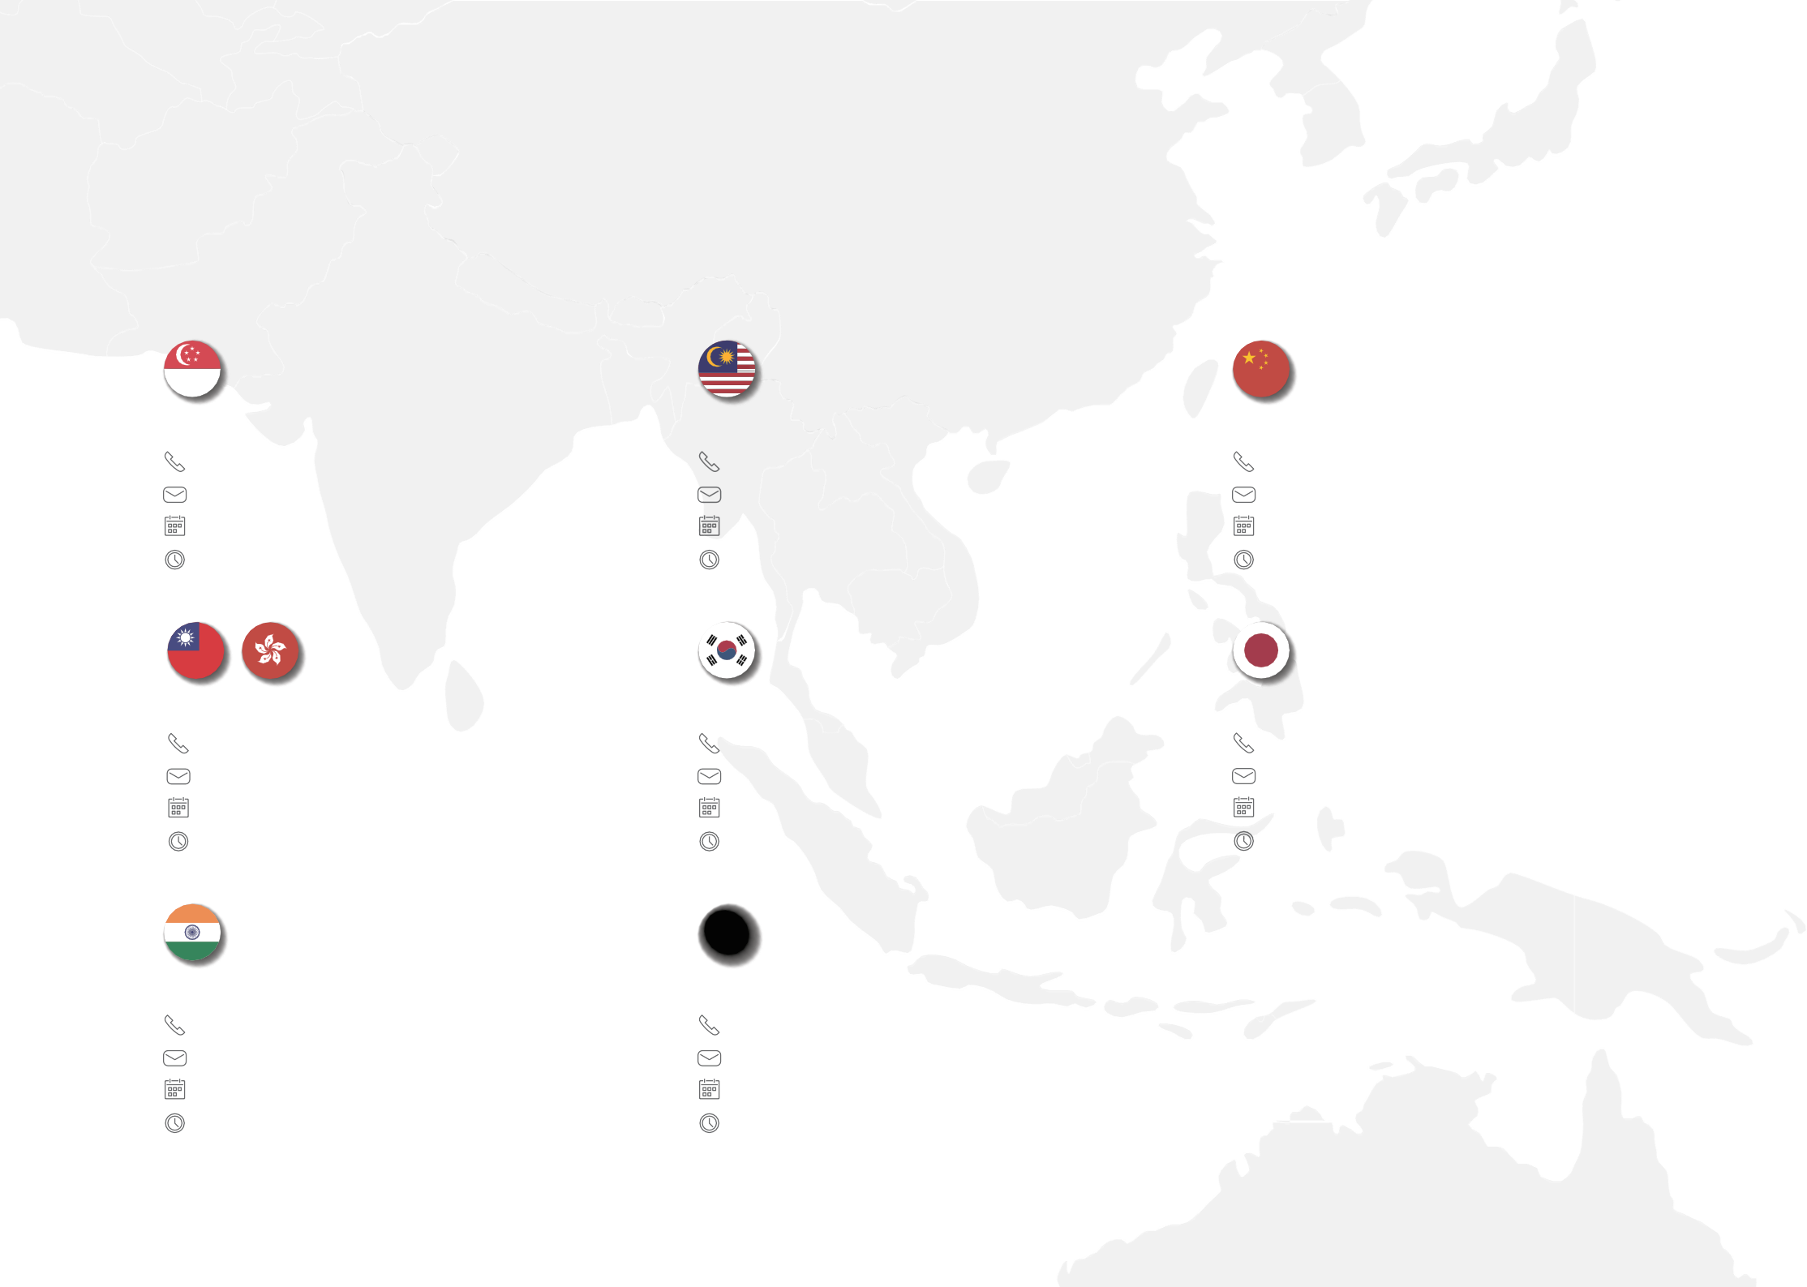
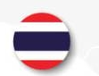

How do I place an order with ExxonMobil?
Contact Information
Customer Service will be your key contact point for ordering, invoicing, payment, feedback and related issues. Weekdays and operating hours are shown below :
Thailand | Malaysia | China Mainland
1800010152 | 1800885684 | 4008423317
chemcs-synthetics@exxonmobil.com | chemcs-synthetics@exxonmobil.com | chemcs-synthetics@exxonmobil.com
Mon – Fri | Mon - Fri | Mon – Fri
08:00 - 17:00 (GMT+7) | 07:30 - 16:30 (GMT+7) | 07:30 - 16:30 (GMT+7)
Taiwan/ Hong Kong | Korea | Japan
00180061600184 | +6620268399 | 00531650493
chemcs-synthetics@exxonmobil.com | chemcs-synthetics@exxonmobil.com | chemcs-synthetics@exxonmobil.com
Mon - Fri | Mon - Fri | Mon – Fri
07:30 - 16:30 (GMT+7) | 07:30 - 16:30 (GMT+7) | 07:30 - 16:30 (GMT+7)
India
0008000504066
chemcs-synthetics@exxonmobil.com
Mon - Fri
09:00 - 18:00 (GMT+7)
Singapore
18007231394
chemcs-synthetics@exxonmobil.com
Mon - Fri
07:30 - 16:30 (GMT+7)
Other countries
+6620268399
chemcs-synthetics@exxonmobil.com
Mon - Fri
07:30 - 16:30 (GMT+7)
3
Notes:
- Corrected operating hours to GMT+7 and adjusted the icon position

Slide 4








₁ New Account Set Up
Ordering
2
Order Process
For first-time customers or existing customers who wish to add new delivery destinations to your account, the following information is required for account/new delivery destination creation:
Online
English: https://exxonmobilchemical.force.com/oneconnect/login
Chinese: https://oneconnect.exxonmobilchemical.com.cn
Online platform (OneConnect) is highly recommended with first time access set up required.
Company address (Sold-to Address)
1 2
Please contact our Customer Service and we will assist you with the access immediately.
Before order placement, we recommend you check order lead time in Page 7 to ensure your expected arrival date could be met.
New delivery destination address (Ship-to Address)
Address in invoice (Bill-to Address)
Required
Contact information
Manual Order
Product you would like to buy
Alternatively, please send below information to our email address.
1 2
Onshore
Marine
Account Set Up Lead Time
Purchase order number Delivery address or Destination
Product Quantity
Required Delivery Date
Purchase order number Product
Quantity
Destination port
Required Delivery Date Shipping documents instruction for example;
Consignee, Notify party, Banks details for bank term customer, etc.
3
2
working days
weeks
customer self pick up
company delivery
In some situations – such as incomplete information received, additional details required, or pending site assessment completion date, etc., it may take longer than initially stated.
4
Notes:
- No comment

Slide 5
















₅ Mode of Transport
3
4
Order Cutoff Time
Order status
Order Commitment
Order Confirmation will be automatically sent to you once your order is confirmed and ready for shipment scheduled.
We provide a variety of transport options, which includes:
Did you know ?
It is important to verify the details in your order confirmation against your purchase order and inform Customer Service if any discrepancies are found.
02:00
Shipment Delivery Notification
Cut-off time for Singapore and Malaysia onshore deliveries
For onshore deliveries in Singapore and Malaysia, please place your online order or contact Customer Service for manual order placement before 2:00 pm local time.
For onshore deliveries in Singapore and Malaysia, please allow 3 working days for order placement in advance of the loading date to ensure sufficient lead time for ordering and logistical processes.
M
r
Onshore truck
Bulk marine
a
e
r
d
i
r
B
r
O
y
n
o
e
n
r
e
r
u
d
e
e
l
r
s
v
I
n
k
h
i
s
i
o
o
l
o
a
m
r
e
c
t
a
e
e
d
o
n
r
n
Please refer to the details in your Order Confirmation. Customer Service will contact you if there are any changes.
i
Did you know ?
For prepayment customers, orders will be processed upon receipt of payment, provided it is received within the cut-off time. (1:00 P.M.)
The shipment schedule will be sent to you via Customer Service or your freight forwarder’s email. Please note that the estimated arrival date may differ from your initially requested date, depending on vessel availability.
Refer to the vessel nomination details for further information. Customer Service will contact you if there are any changes from vessel nomination.
Marine Isocontainer
For more details about each transport mode and ensure your expected arrival date is met from your location, please contact our Customer Service team.
5
Notes:
Removed “Orders received within the cut-off time will be processed on the same day for next-day loading. Orders received after the cut-off time will be processed in the next working day.
Removed “For onshore deliveries to Malaysia, order lead time is 3 working days in advance of the loading date. Loading and delivery do not occur on the same day.”

Slide 6

How will I be billed?
How can I pay my bill?
Singapore onshore delivery: An electronic copy of the invoice will be sent to you automatically via email.
Malaysia onshore delivery: The invoice will be handed to you by our truck driver along with other documents.
Malaysia self pick-up customers: The invoice will be provided to your driver together with other documents upon completion of loading at the terminal.
Marine orders: The invoice will be sent along with shipping documents by the freight forwarder.
Bank of America Merrill Lynch is our main service bank. There are two main payment methods that we offer including Telegraphic Transfer and bank swift.
Telegraphic Transfer (T/T)
When remitting payment, please include our invoice number or sales order number for reference.
For prepayment orders, kindly provide your bank slip and order number to our Receivables team’s shared mailbox at CHEM.InvoicesAP@O2C-ExxonMobil.com to proceed with order processing.
Did you know ?
To avoid any impact on your future order, please make payment before due date stated in the invoice.
T/T
How do I change/ cancel my order?
SWIFT
Bank Swift Transfer
Remittance via bank SWIFT code applies only to Document Against Acceptance and Document Against Payment payment methods.
You may make changes to your orders as long as it has not been confirmed or booked. Please contact our Customer Service team to check the order status for immediate support. Any changes after order confirmation or booking may result in additional charges.
For bulk marine orders, to prevent dead freight charges, orders cannot be changed after vessel acceptance.
6
Notes:
- Corrected SMB to “Shared Mailbox” and added RCS’s shared mailbox

Slide 7
How long in advance do I need to prepare for my order?
To ensure on-time delivery in accordance with ExxonMobil’s delivery lead time, please place your order in advance – prior to the minimum transportation transit time indicated in the table below. The estimated transportation transit time includes both loading and transit duration from our loading point to your unloading location. Please note that the transit time provided is subject to product and vessel/truck availability.
Transportation Mode | Loading Country | Destination Area | Average transportation transit time (days)
Marine Isocontainer | Singapore | Australia | 35
 |  | China | 45-60
 |  | Hong Kong | 40
 |  | Indonesia | 25
 |  | India | 30-60
 |  | Japan | 35-40
 |  | Thailand | 25-30
 | France | Australia | 80
 |  | China | 60-80
 |  | Hong Kong | 70
 |  | India | 60-80
 |  | Japan | 80
 |  | Korea | 80
 |  | Singapore | 65
 |  | Vietnam | 65
 | US | China | 65-95
 |  | India | 75-95
 |  | Japan | 75-80
 |  | Korea | 75-80
 |  | Singapore | 70-75
 |  | Thailand | 70-75
Transportation Mode | Loading Country | Destination Area | Average transportation transit time (days)
Onshore | Singapore | Within Singapore | 1
 |  | Malaysia (All states except Perlis) | 2
 |  | Malaysia (Perlis) | 4
For bulk shipments, please inform your Sales Representative of your product requirements 3 months in advance, and place your order 1 month prior to the loading date. This allows sufficient time for product preparation and vessel arrangement.
The minimum sailing time listed below refers to the transit time from our loading point to your unloading location (subject to the number of port calls and port rotation).
Transportation Mode | Loading Country | Destination Area | Average transportation transit time (days)
Bulk Liquid Marine | France | China | 50-70
 |  | Singapore | 55
 | US | Japan | 60
7
Notes:
Corrected subject
Rounded up/down number of days
Changed the background color / font size / position (middle)

Slide 8

What order quantities are available?
Onshore Truck
Below is the recommended order volume per truck.
Mode of Transport | Product | Metric tons
Onshore Truck | SPECTRASYN 2C | 18.00
Onshore Truck | SPECTRASYN 4 | 19.00
Onshore Truck | SPECTRASYN 8S | 19.00
 | SPECTRASYN 40 | 19.00
 | SPECTRASYN 100 | 19.00
 | SPECTRASYN ELITE 65 | 19.00
 | SPECTRASYN ELITE 150 | 19.00
Metric tons
Suggested Order Quantity for Onshore Trucking
8
Notes:
Corrected subject
Add 2 places decimal / changed position (middle)

Slide 9

Marine Isocontainer Delivery
We provide delivery using marine Isocontainers. A maximum of 9 Isocontainers can be accommodated in a single order.
Below is the optimum quantity for each Isocontainer.
Bulk Marine Shipment Guidelines
Subject to the minimum port call quantity, the table below shows the typical minimum quantity for Bulk Marine shipments. However, please confirm the final order quantity with your Sales Representative before placing an order.
Mode of Transport | Product | Metric tons
Marine Isocontainer | EMDC 3152 | 18.80
 | EMDC 3220 | 19.20
 | EMDC 3235 SUPER | 19.95
 | EMDC 3250 | 19.50
 | ELEVAST A80 | 19.50
 | ESTEREX A32 | 19.00
 | ESTEREX A51 | 19.00
 | ESTEREX NP343 | 19.00
 | ESTEREX NP451 | 19.00
 | ESTEREX P61 | 20.50
 | PURESYN 2 | 19.00
 | PURESYN 4 | 19.00
 | PURESYN 6 | 19.00
 | SPECTRASYN 2 | 18.80
 | SPECTRASYN 2C | 18.00
 | SPECTRASYN 4 | 19.20
 | SPECTRASYN 4S | 19.00
 | SPECTRASYN 6 | 19.50
 | SPECTRASYN 8 | 19.50
 | SPECTRASYN 8S | 19.00
 | SPECTRASYN 10 | 19.70
 | SPECTRASYN 40 | 19.00
 | SPECTRASYN 100 | 19.50
 | SPECTRASYN ELITE 65 | 19.00
 | SPECTRASYN ELITE 150 | 19.00
 | SPECTRASYN ELITE 300 | 19.00
 | SPECTRASYN MAX 3.5 | 19.95
 | SPECTRASYN PLUS 3.5 | 19.00
 | SPECTRASYN PLUS 6 | 19.00
 | SYNESSTIC 5 | 19.00
 | SYNESSTIC 12 | 19.00
Mode of Transport | Minimum Order Quantity
Bulk Marine (Cross region) | Ex-US 200metric tons/product Ex-EU 400metric tons/product
Suggested Order Quantity for Bulk Marine
Suggested Order Quantity for Isocontainer
9
Notes:
Changed back to Isocontainer
Added 2 places decimal
Changed position (middle)

Slide 10
How can I load my products from ExxonMobil Terminal?
Operating Hours and Loading Guidelines
Each terminal operates on different working days and hours. Please be aware of their standard operating schedules when planning truck loading at the terminals. We recommend scheduling truck loading within the terminal’s working day and hours to avoid delays.
Self pick-up - Vopak Penjuru Terminal
Drivers must arrive before or within the designated time slot. Failure to do so may result in loading being rejected.
Any overtime request, is subjected to Terminal approval and may incur additional costs.
Self pick-up - SH Cogent Jurong Island Logistics Hub (JILH)
Drivers must arrive before 4:30 PM to ensure sufficient lead time for loading.
Drivers are required to present a “lorry chit, “EM order confirmation”, or “EM Pre-shipment notification” document for verification upon collection. This document may be in the transporter’s own format; however, it must include the following critical details: Driver’s name, Vehicle number, EM Sales Order number and Isotank number to be collected
Truck/Driver Registration
For first-time access, customer pick-up trucks loading for both road tankers and Iso-tanks must comply with truck filling rules, except for compartmentalized road tankers and baffled Iso-tanks. Additionally, tanks must be clean and dry; otherwise, trucks may be refused loading due to product quality concerns.
Completion of SIC (Safety Induction Course) is mandatory for new drivers before entering the terminal.
Please contact the designated person in charge for the truck registration process and SIC scheduling in advance of the first loading to avoid unintended loading interruptions.
Remark: Any changes/modifications to the prime mover or tanker after registration must be communicated to the person in charge before arranging the next loading.
Country | Terminal | Contact Number
Singapore | Vopak Penjuru | Customer Service (Ong Chin Siong) (chin.siong.ong@vopak.com) T: +65 68679146, HP: +65 91297750 Copy the following email in loop Trucking Team (trucking.penjuru.sg@vopak.com) On-Line SIC and Assessment is required
Singapore | SH Cogent Jurong Island Logistics Hub (JILH) | Customer Service (Daryl Ng) (Daryl.Ng@sh-cogent.com) T: +65 67277727 Copy the following email in loop Bulk Liquid CS (bl.cs@sh-cogent.com.sg) SIC is not required
Country | Terminal | Working Day | Working Hours (SG time)
Singapore | Vopak Penjuru | Mon-Fri (ex.PH) | 8:30 AM to 4:30 PM (Timeslot booking for loading is required. Vopak Slot Booking > LINK)
 | SH Cogent Jurong Island Logistics Hub (JILH) |  | 8:30 AM to 5:30 PM No specific timeslot booking for collection. Please inform the terminal coordinator at least 2 working days in advance to arrange your collection.
Contact Information for Truck/Driver Registration of Each Terminal
Operating Hours of Each Terminal
10
Notes:
Moved SH Cogent terminal instructions to be under “Self pick-up - SH Cogent Jurong Island Logistics Hub (JILH)”
Changed font / position (middle) / background color

Slide 11






















How do I count demurrage and detention days?
₁ Isocontainer - Demurrage & Detention Guidelines
Isocontainer Demurrage and Detention charges begin from the time the isocontainer is discharged at destination port. Customers can refer to the Demurrage & Detention Free Days stated on the Bill of Lading. Please note that Demurrage & Detention Free Days do not cover Port Storage, Port Demurrage, or Quay Rent. To avoid additional rental charges, please ensure that empty containers are returned within the Demurrage & Detention Free Days. For further information or inquiries, please contact Customer Service.
Quay rent per port authority (port demurrage or store rent)
discharging collecting
discharging
returning container
Inside port
Outside port
Outside port
port
buyer’s WHS carrier’s depot
Isocontainer demurrage
Free days exclude store/quay rent
Isocontainer detention
Free days after the isocontainers leave the port
₂ Onshore Truck Detention Reminder
₃ Bulk Marine Demurrage & Laytime Information
Please ensure that the truck is fully discharged as early as possible to avoid additional truck detention charges for overnight unloading.
Demurrage details and laytime allowances will be provided during the vessel nomination process. Please ensure that the bulk marine vessel is fully discharged as early as possible to minimize the risk of incurring additional demurrage charges.
11
Notes:
- Changed back to Isocontainer

Slide 12

Can I expedite my order?
What type of documents will I receive with my shipment?
The standard documentation set will be provided to you as follows:
Transportation Mode Documents Offering
If you would like to receive the product at your site earlier than the standard lead time, please contact our Customer Service team to check the possibility of a rush order.
Please note that rush orders may incur additional charges.
Delivery Note
Weighbridge Ticket
Certificate of Analysis (COA)
Commercial Invoice (for Malaysia Only)
Bill of Lading (B/L)
Commercial Invoice
Packing list
Certificate of Origin (COO)
Certificate of Analysis (COA)
Bill of Lading (B/L)*
Surveyor Report at Load port
Commercial Invoice 1/1
Packing list 1/1
Certificate of Origin (COO) 1/1
Certificate of Analysis (COA) 1/1
Onshore Truck
Can I request a sample from ExxonMobil?
If you would like to request a product sample, please contact our Sales Representative. Alternatively, you may submit a sample request through our online platform.
Marine Isocontainer
Bulk Marine
Documents Offering
For additional shipping documents required such as Certificates of Origin (PCOO), e.g., ASEAN Trade in Goods Form D, or any other specific importing country documentation, please indicate your requirement in your PO or contact Customer Service team.
How do I provide feedback to ExxonMobil?
Your feedback is valuable to us and helps improve the overall customer experience. You may provide feedback through our Customer Service team or via our online platform.
Timely customer feedback is critical to Marine Container Transportation team. Please note that the carrier and freight forwarder will not conduct investigations if the Customer Feedback is submitted more than one month after the Actual Time of Arrival.
12
Notes:
- Corrected MCT / GFF to the full word.

Slide 13
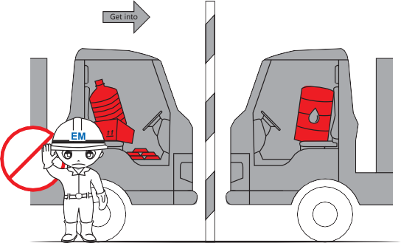
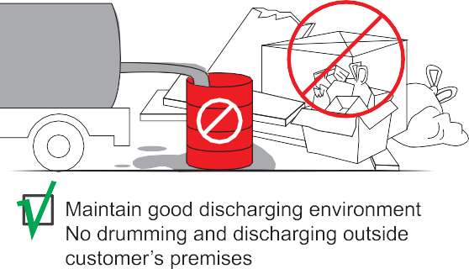
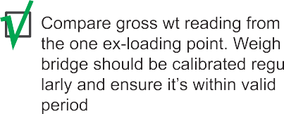


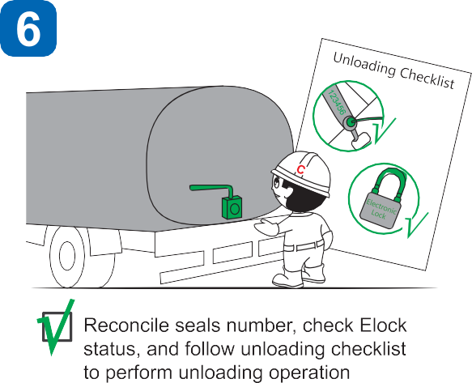

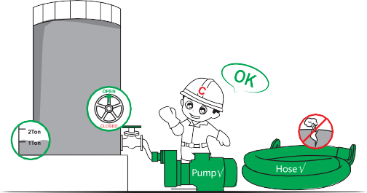

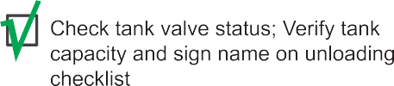
How do I unload a product?
13

Slide 14
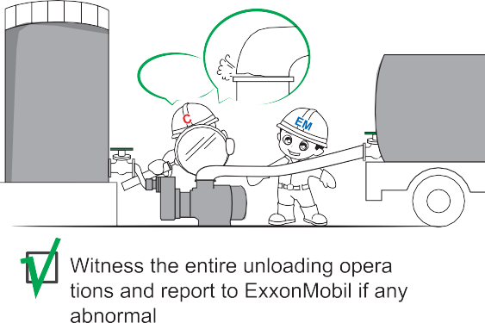
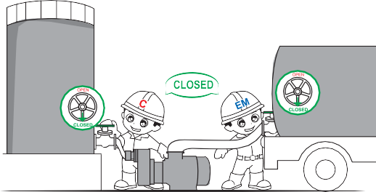
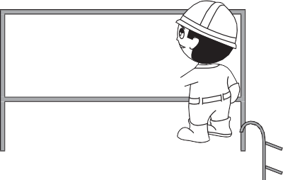




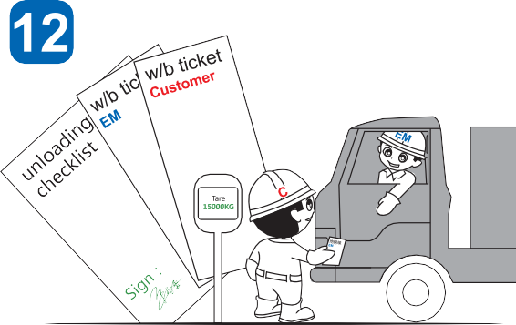
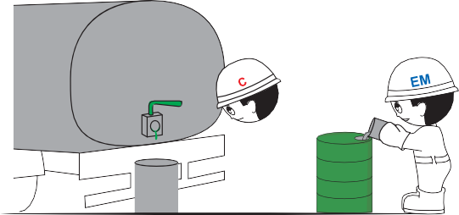
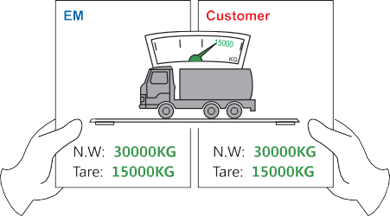


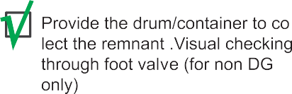

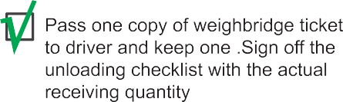
Oh no!
14

Slide 15




ExxonMobil Chemical Asia Pacific
(A division of ExxonMobil Asia Pacific Pte. Ltd.) 1 HarbourFront Place, #06-00,
HarbourFront Tower One, Singapore 098633
www.exxonmobilchemical.com
Statements:
Company shall have the right to revise this Standard Offering at any time without notifying customers, provided that any such revision shall not lower the offer and service standard that customers enjoy. ExxonMobil shall notify customers of any such revision(s) within a reasonable period after such revision(s).
The Standard Offering described in this document is the typical service offering Company provides to its customers. Informations provided by Company herein, including, but not limited to, lead time, order cutoff time, terminal operating hours, and standard documents may vary dependings on the specific situation.
CORPORATE SEPARATENESS NOTICE:
The terms “we,” “our,” "ExxonMobil Chemical" and "ExxonMobil" are each used for convenience, and may include any one or more of ExxonMobil Chemical Company, Exxon Mobil Corporation, or any affiliate either directly or indirectly stewarded. Management of each affiliate or other local entity implementing this guidance retains ultimate responsibility for adopting and implementing this guidance in its country or area of operation. Each affiliate or other local entity has chosen to adopt and implement this guidance following its appropriate decision making procedures. Working relationships discussed in this document do not necessarily represent a reporting connection, but may reflect a functional guidance, stewardship or service relationship. Where shareholder consideration of a local entity matter is contemplated by this document, responsibility for action remains with the local entity. Nothing contained in this document is intended to override corporate separateness of local entities.

